Slide 1
LA290S V-Flex Evaluation
January 2020

Slide 2
LA290S V-Flex Evaluation
Product
The LA Series cables provides the best available combination of low attenuation, phase stability and mechanical performance. For example, the LA290S cable provides <20 dB/100ft of signal loss at 18 GHz with a .290” overall diameter. Additionally, the carefully engineered construction provides excellent bend and crush resistance properties when compared to other ultra low loss cables.
Scope
Evaluate and document the flexure performance of LA290S using the V-flex machine and collect baseline performance data.

Slide 3
LA290S V-Flex Evaluation
Test Sample
3ft cable assembly of LA290S cable terminated with standard straight SMA connectors. Strain relief boots were also used between the rear nut of the SMA connector and the cable.
Test Equipment
Motorized V-flex machine with counter
Mandrel set – 4.8” O.D.
Keysight Technologies (Agilent) PNA Microwave Network Analyzers - E8361A (10MHz to 67GHz) (hereafter referred to as PNA)

Slide 4
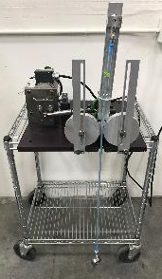
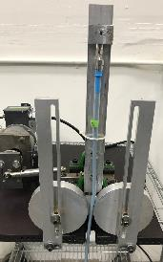
LA290S V-Flex Evaluation
Testing Method
Prepare sample cable assembly
Perform baseline tests on the sample cable assembly. Baseline tests include VSWR, IL, and Phase Length
Install mandrel set
Set V-flex machine to cycle -90º to +90º flexure angle (ref. image on right)
Connect one end of the assembly on the provided connector on the V-flex machine (ref. image on right)
Load weight on the opposite end of the cable. This weight is just to keep the cable down and steady during flexing and is for reference only
Run V-flex machine for specified amount of cycles – see Testing in Progress video on page 5
Stop machine at desired cycle and repeat tests performed at above in Step #2 (VSWR, IL, and Phase Length)
Record data and complete analysis

Slide 5
LA290S V-Flex Evaluation
Testing in Progress Video

Slide 6
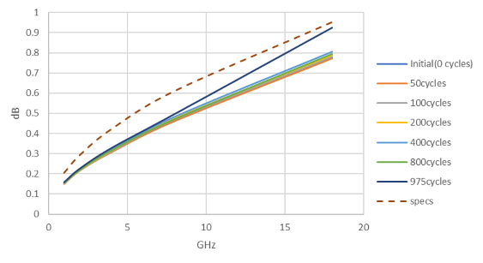
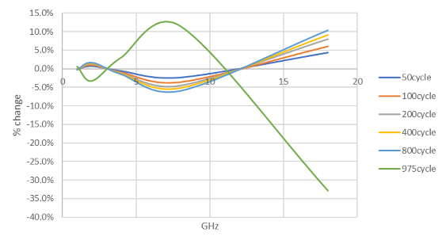
LA290S V-Flex Evaluation
Loss vs Flex Cycle
Phase vs Flex Cycle

Slide 7
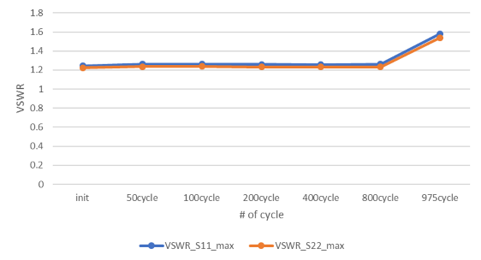
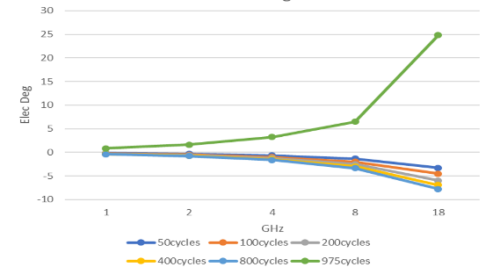
LA290S V-Flex Evaluation
Max VSWR
Phase Change

Slide 8
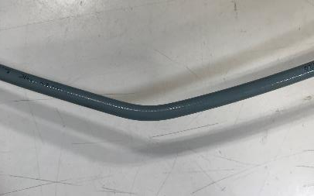
LA290S V-Flex Evaluation
Summary
800 V-flex cycles and less – produces minimum degradation
975 V-flex cycles – fail point reached; when the sharp
bend developed, the V-flex was stopped. Upon
inspection, noticed that the conductor was about
to break, and degradation was evident in tests.
Note that the result is based on one data point only with the given set conditions. This is a good baseline data but other factors like bending radius, mounting/fastening condition can significantly impact the flex cycle life performance of the cable hence need careful consideration and evaluation.

